Slide 1
Story Keeper
The Journal of Heroes
Tristan Barajas(Project Manager) Christian Boyd(Lead designer) Tristan Willis(Table-Top RPG specialist)

Slide 2
Overall Problem
Tabletop games are way too slow!
Taking notes takes way too long and slows down the campaign
Finding notes can take a while
Notes can’t be organized immediately for use later in the same session

Slide 3
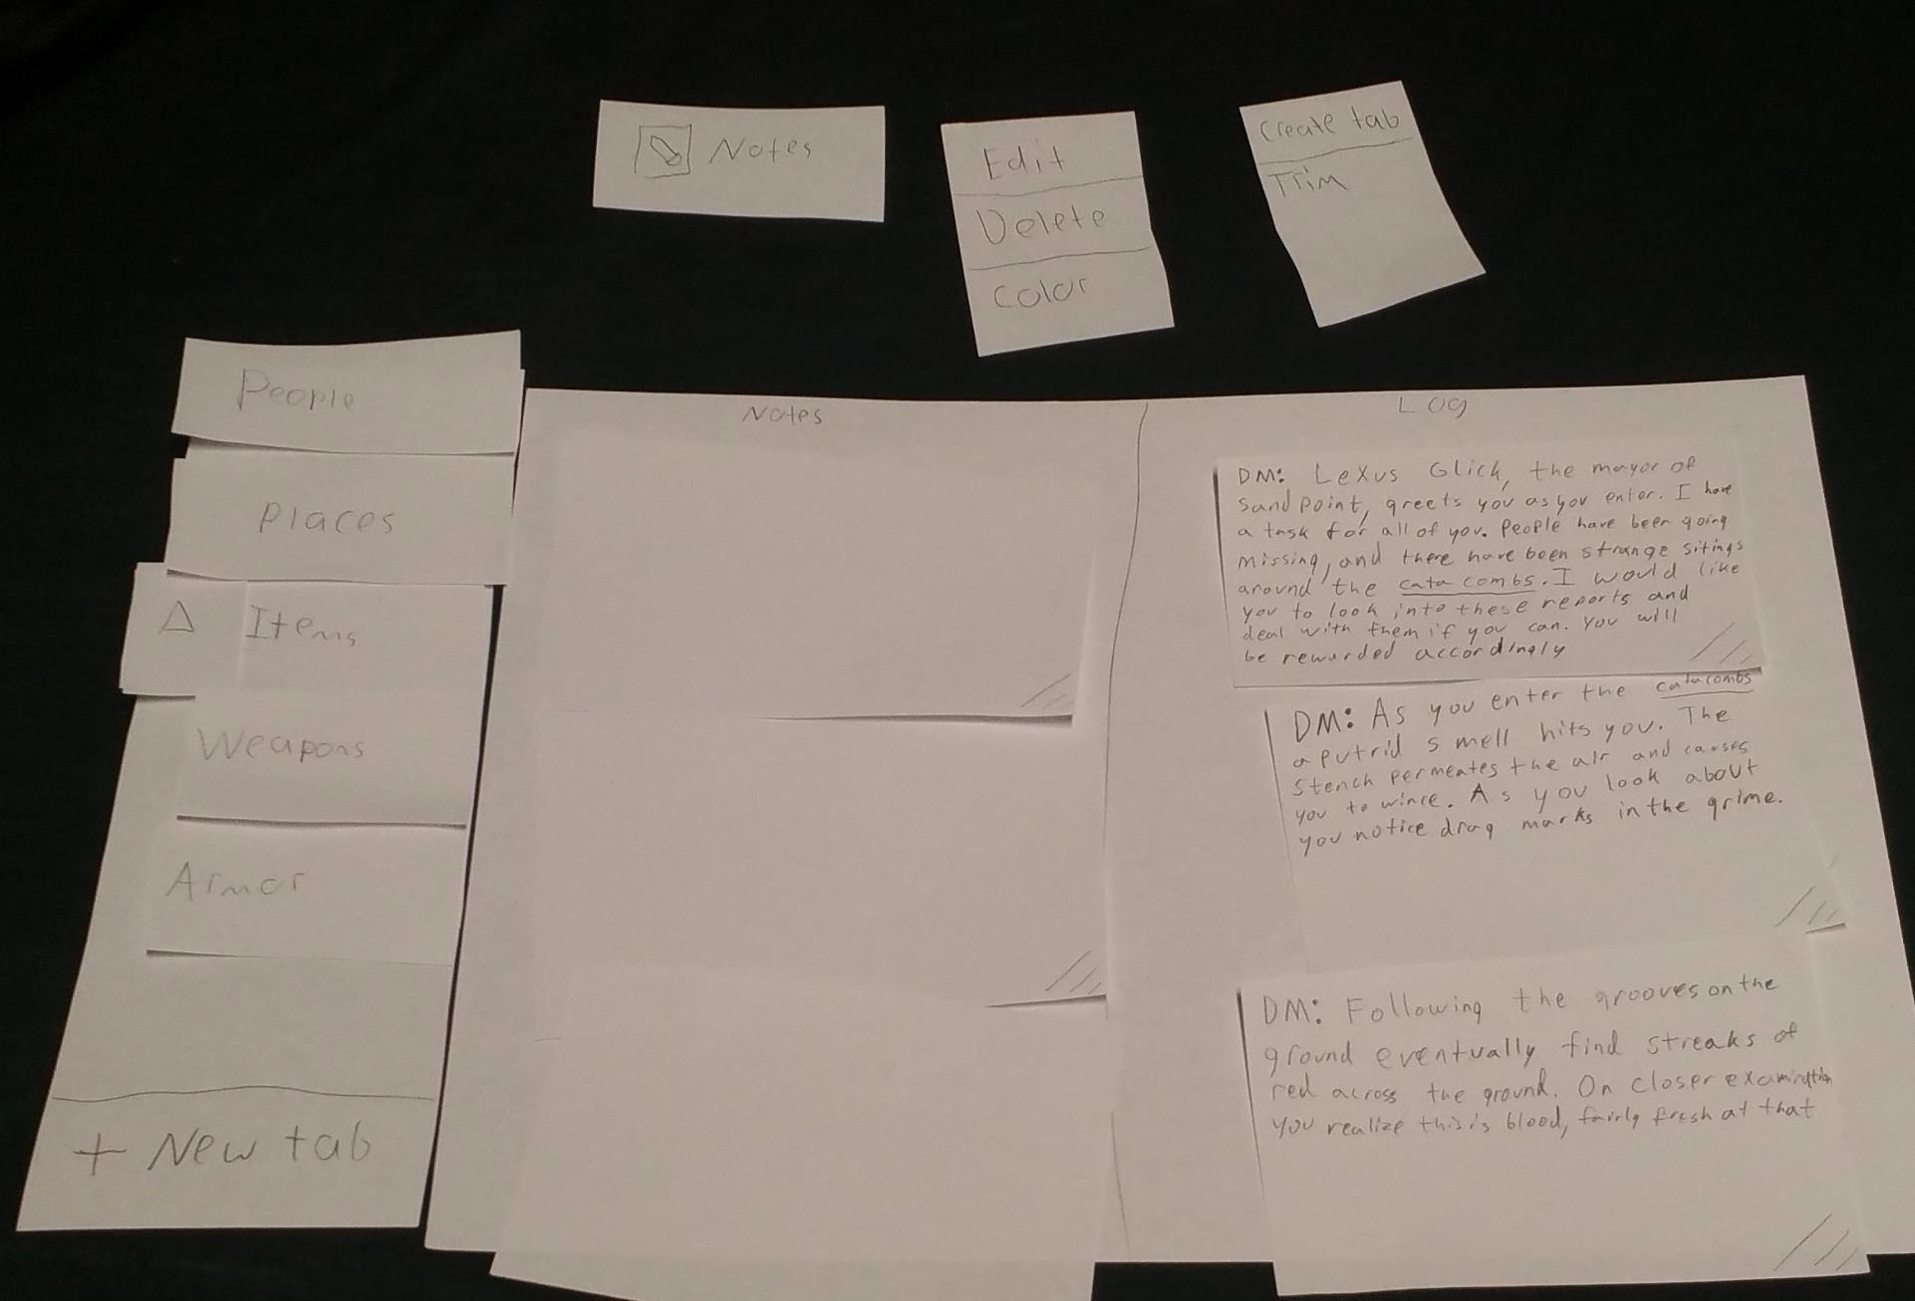
Initial Paper Prototype

Slide 4
Task 1: Write a note and organize it

Slide 5
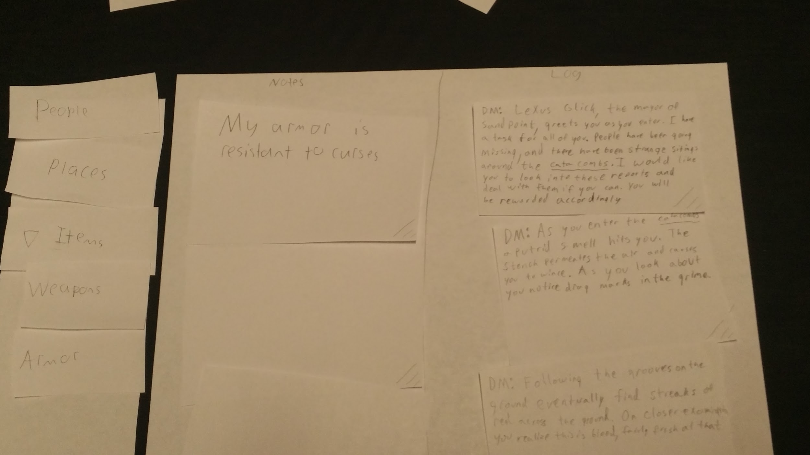
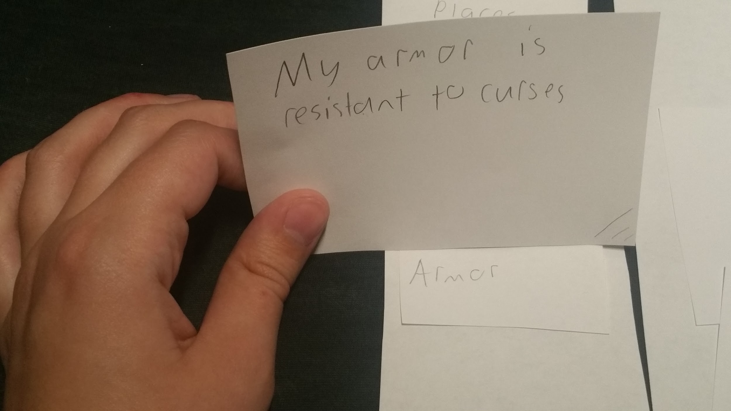

Slide 6
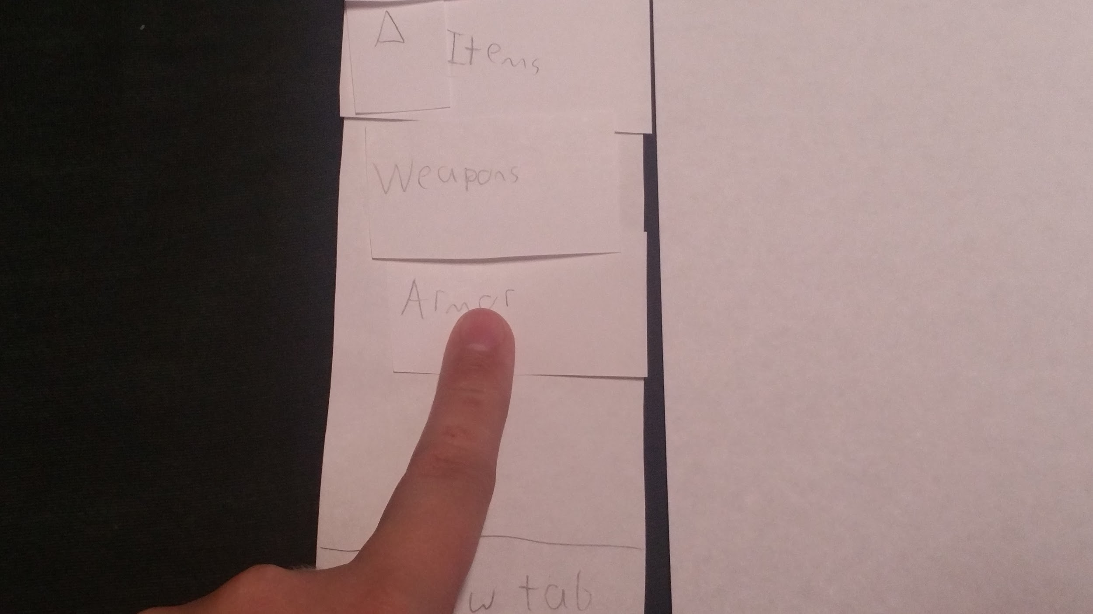
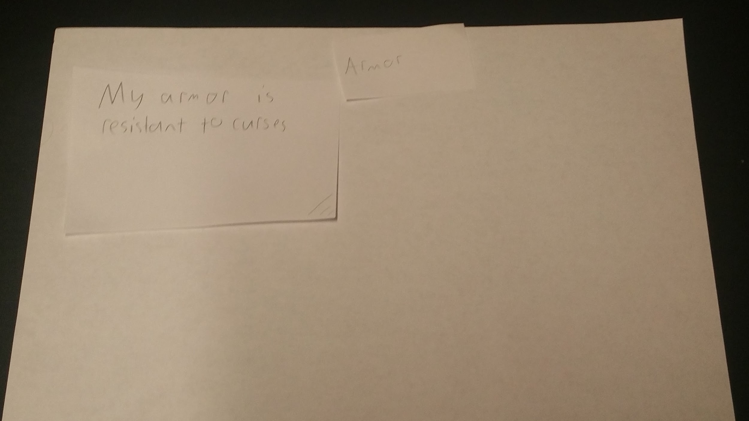

Slide 7
Task 2: Organize Information from the Game Log

Slide 8
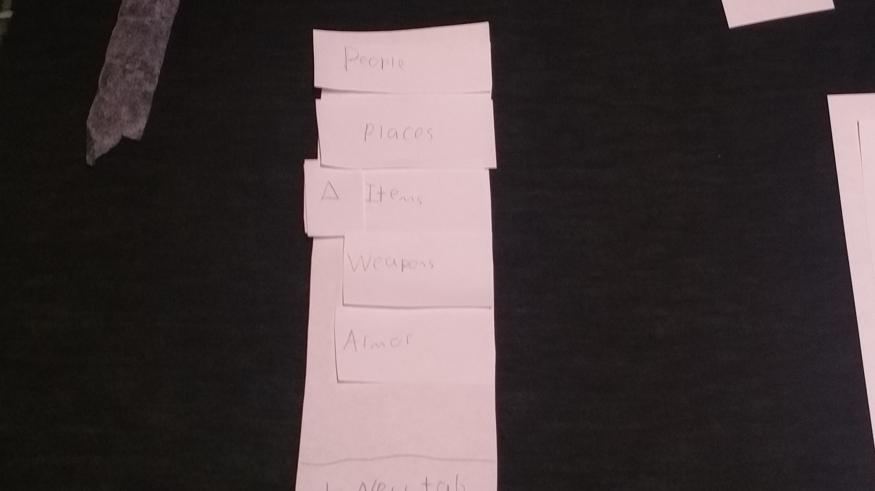
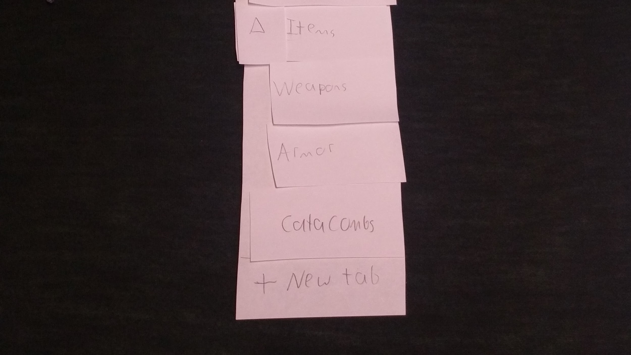

Slide 9
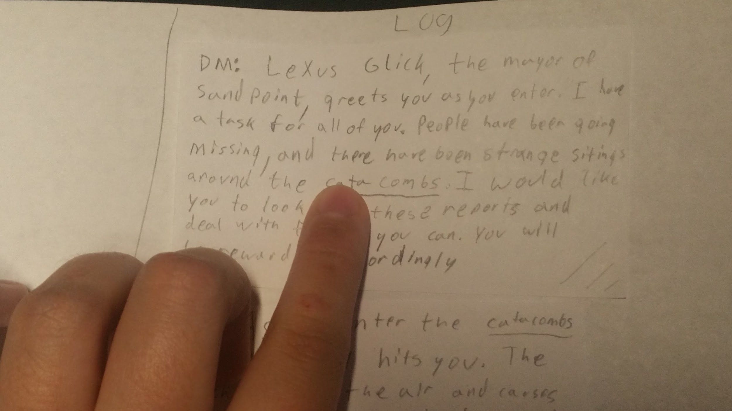
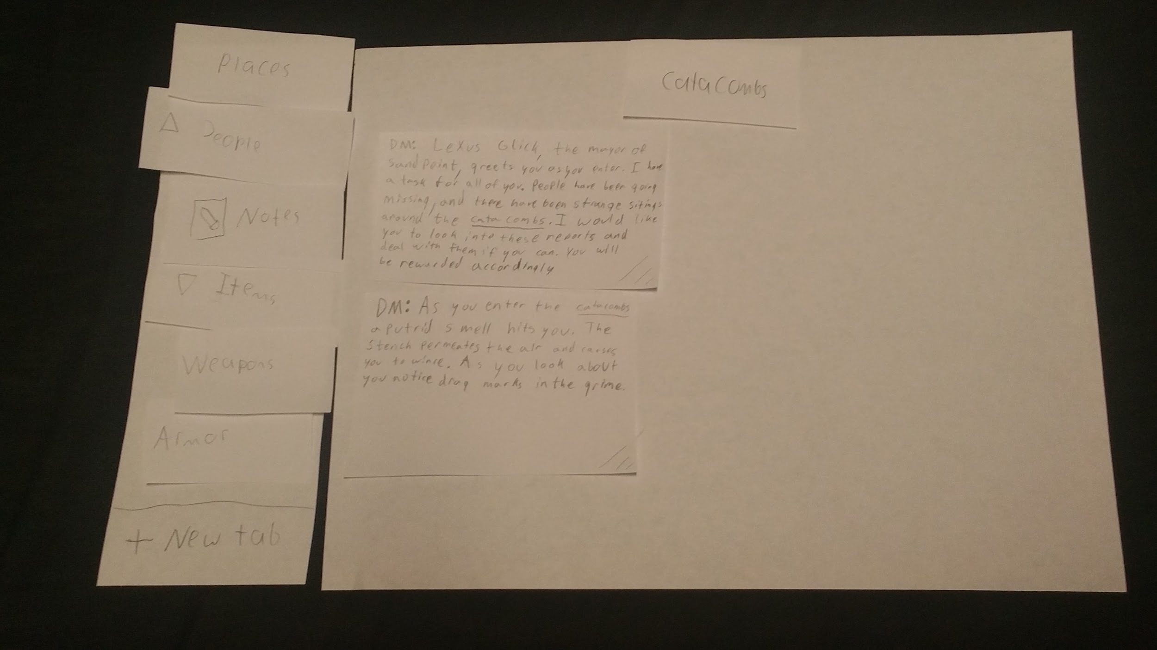

Slide 10
Heuristic Eval.
We discovered we were missing a help section
Many icons were not clear and needed updating

Slide 11
Usability tests
Participants:
David
Occasionally plays D&D
Has played for 2 years
Chose due to experience both with digital interfaces and D&D
Craig
Has played once or twice
Chose because we needed a variety of user skill levels.
Steven
Has heard of D&D, but never played.
Has experiences creating interfaces as well as experience using them.
Chosen for experience with interfaces

Slide 12
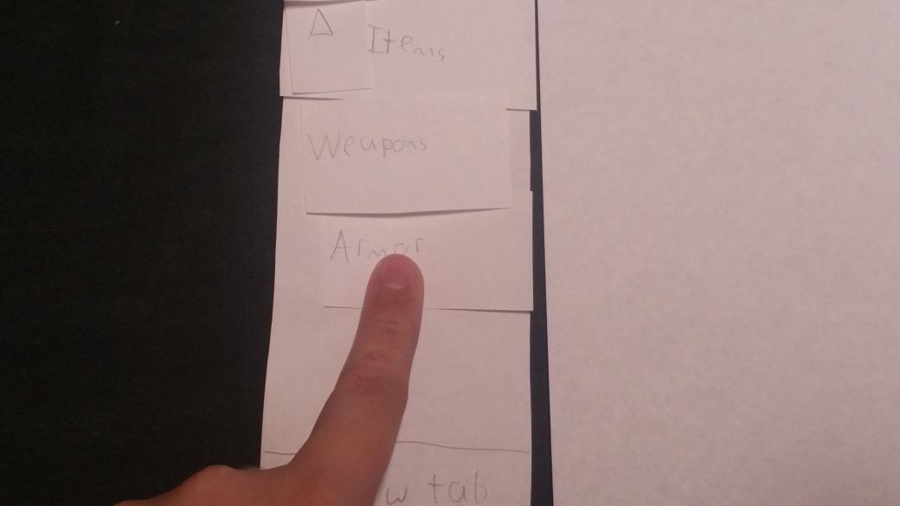

Usability tests
Results:
Our design wasn't clear
Couldn’t tell what was draggable
Couldn’t tell that drop downs were there
So we redesigned
Focused on clear and concise

Slide 13
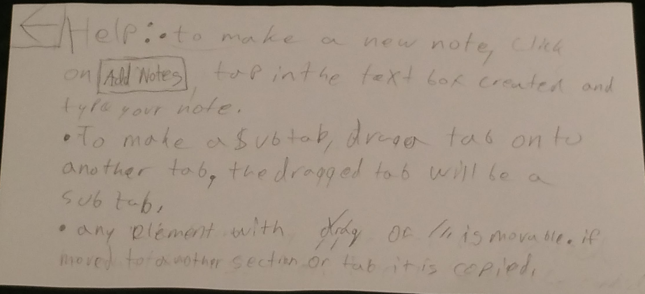
Major changes
Help menu added

Slide 14
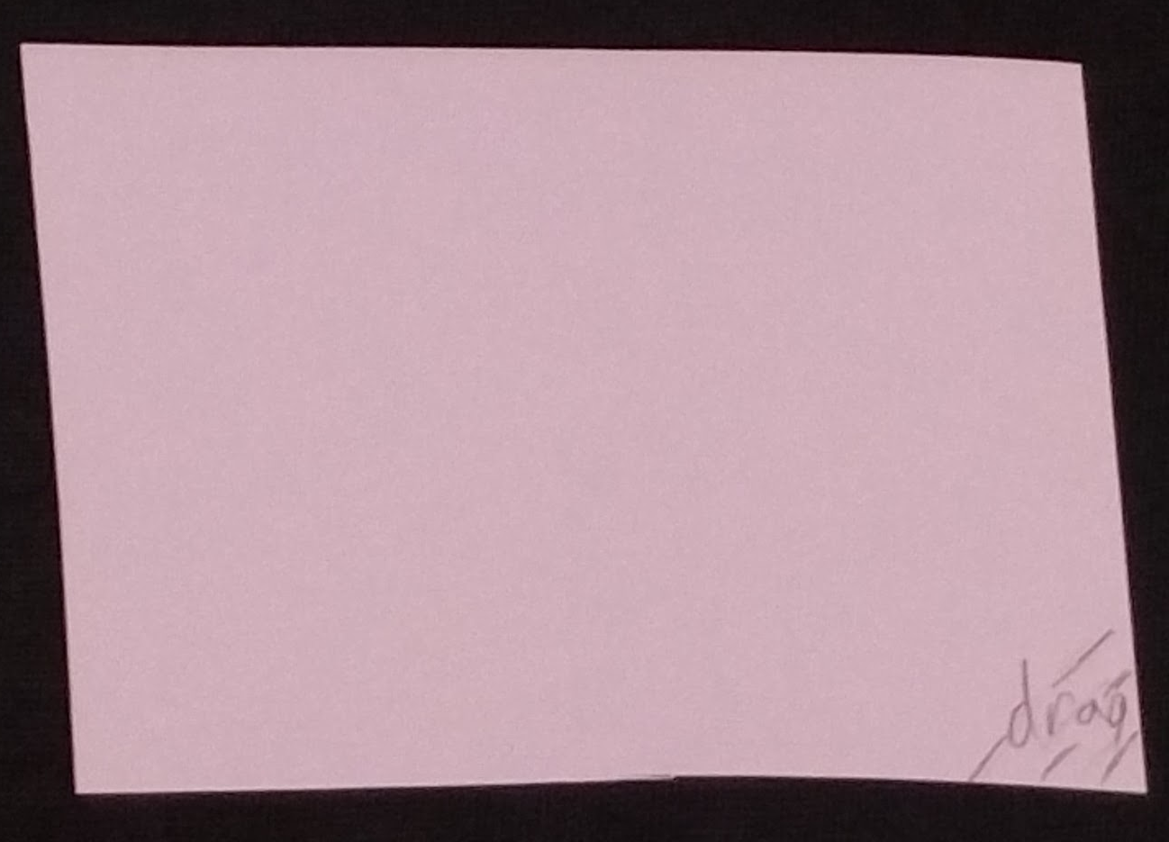
Major changes
Drag tabs made more explicit.
(This was further changed for the digital mockup)

Slide 15
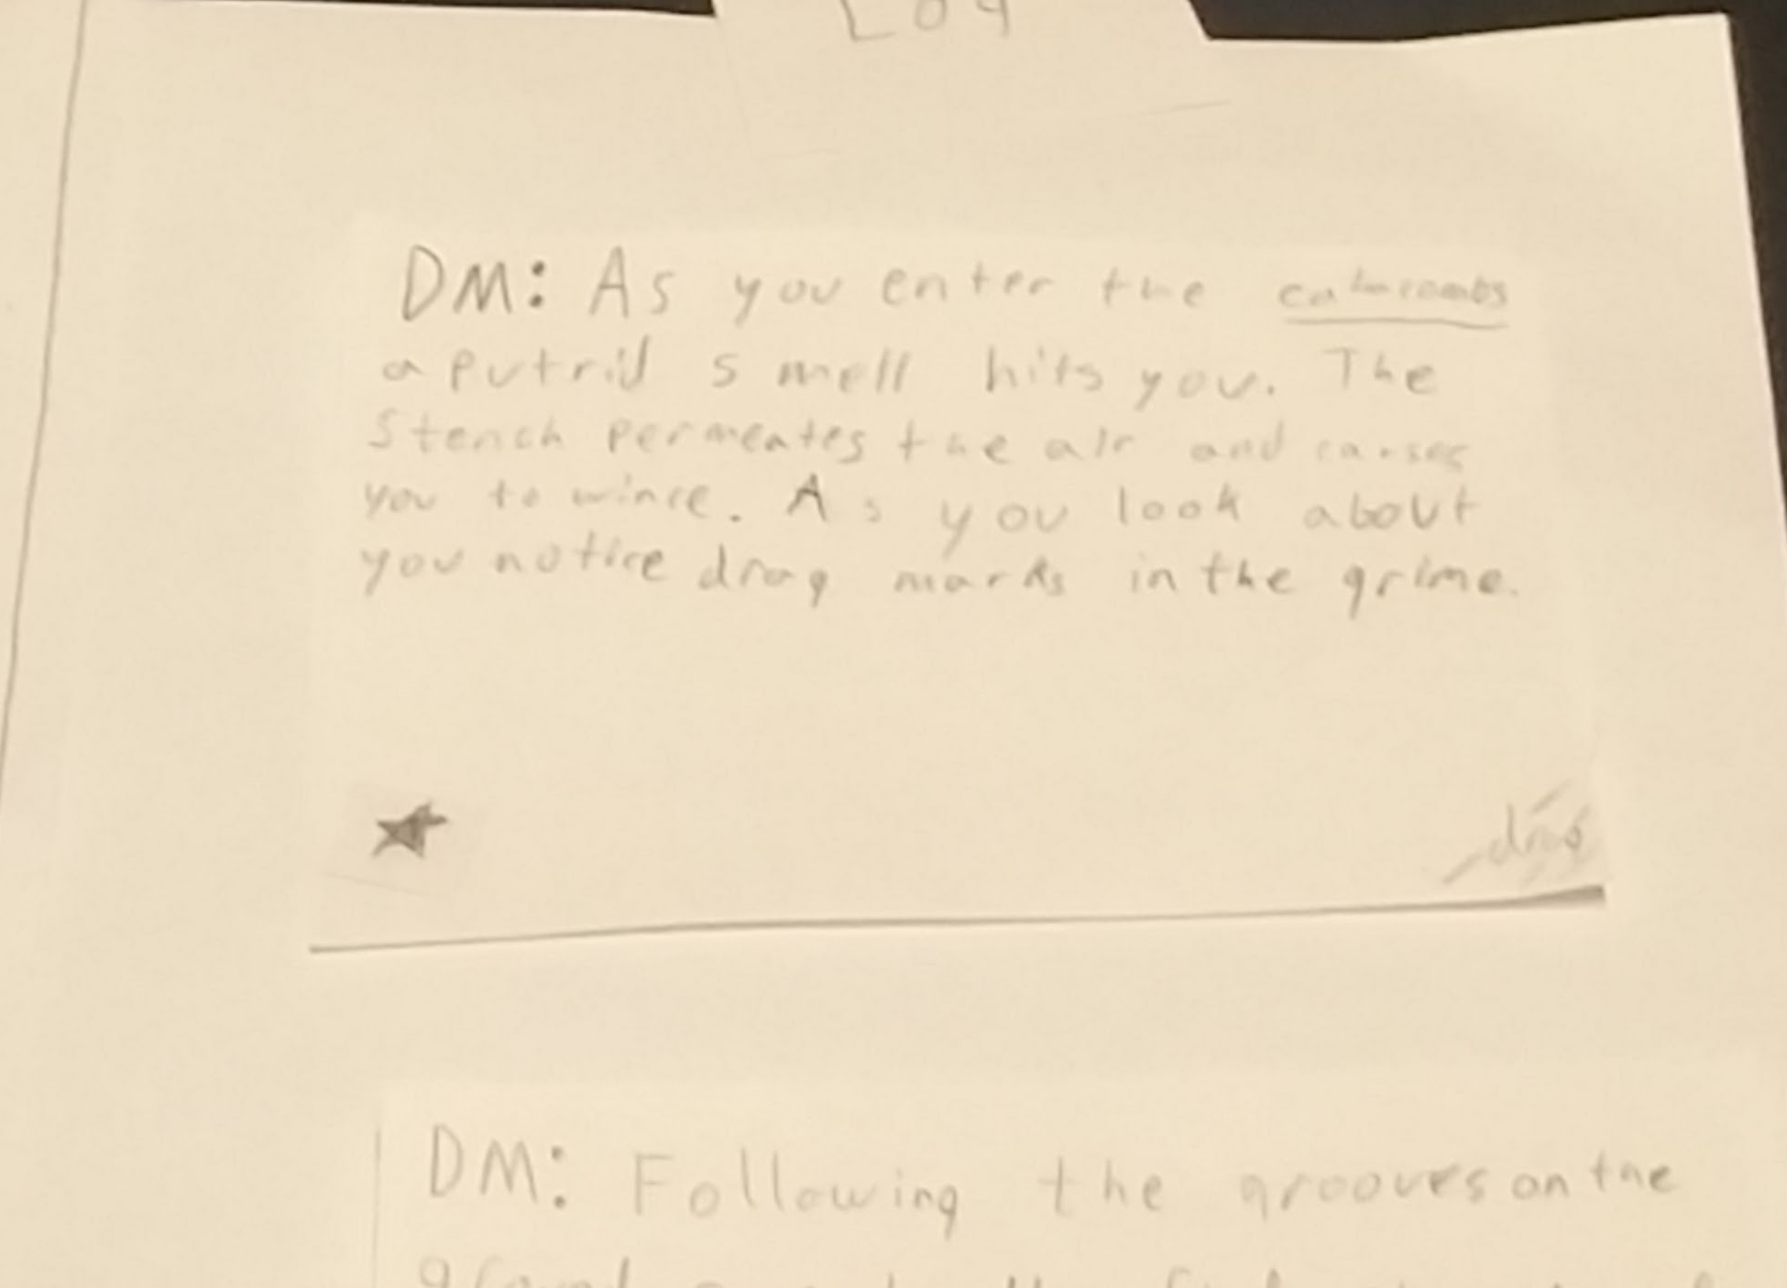
Major changes
Users can now ‘star’ notes from the log. Marking them as important

Slide 16
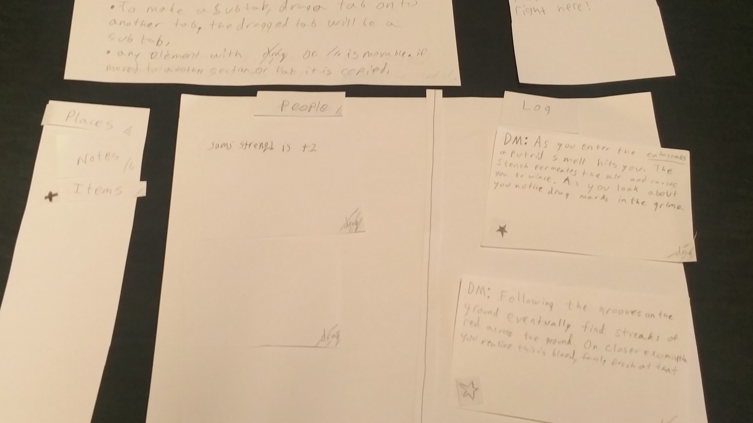
Final Prototype
Overview:

Slide 17
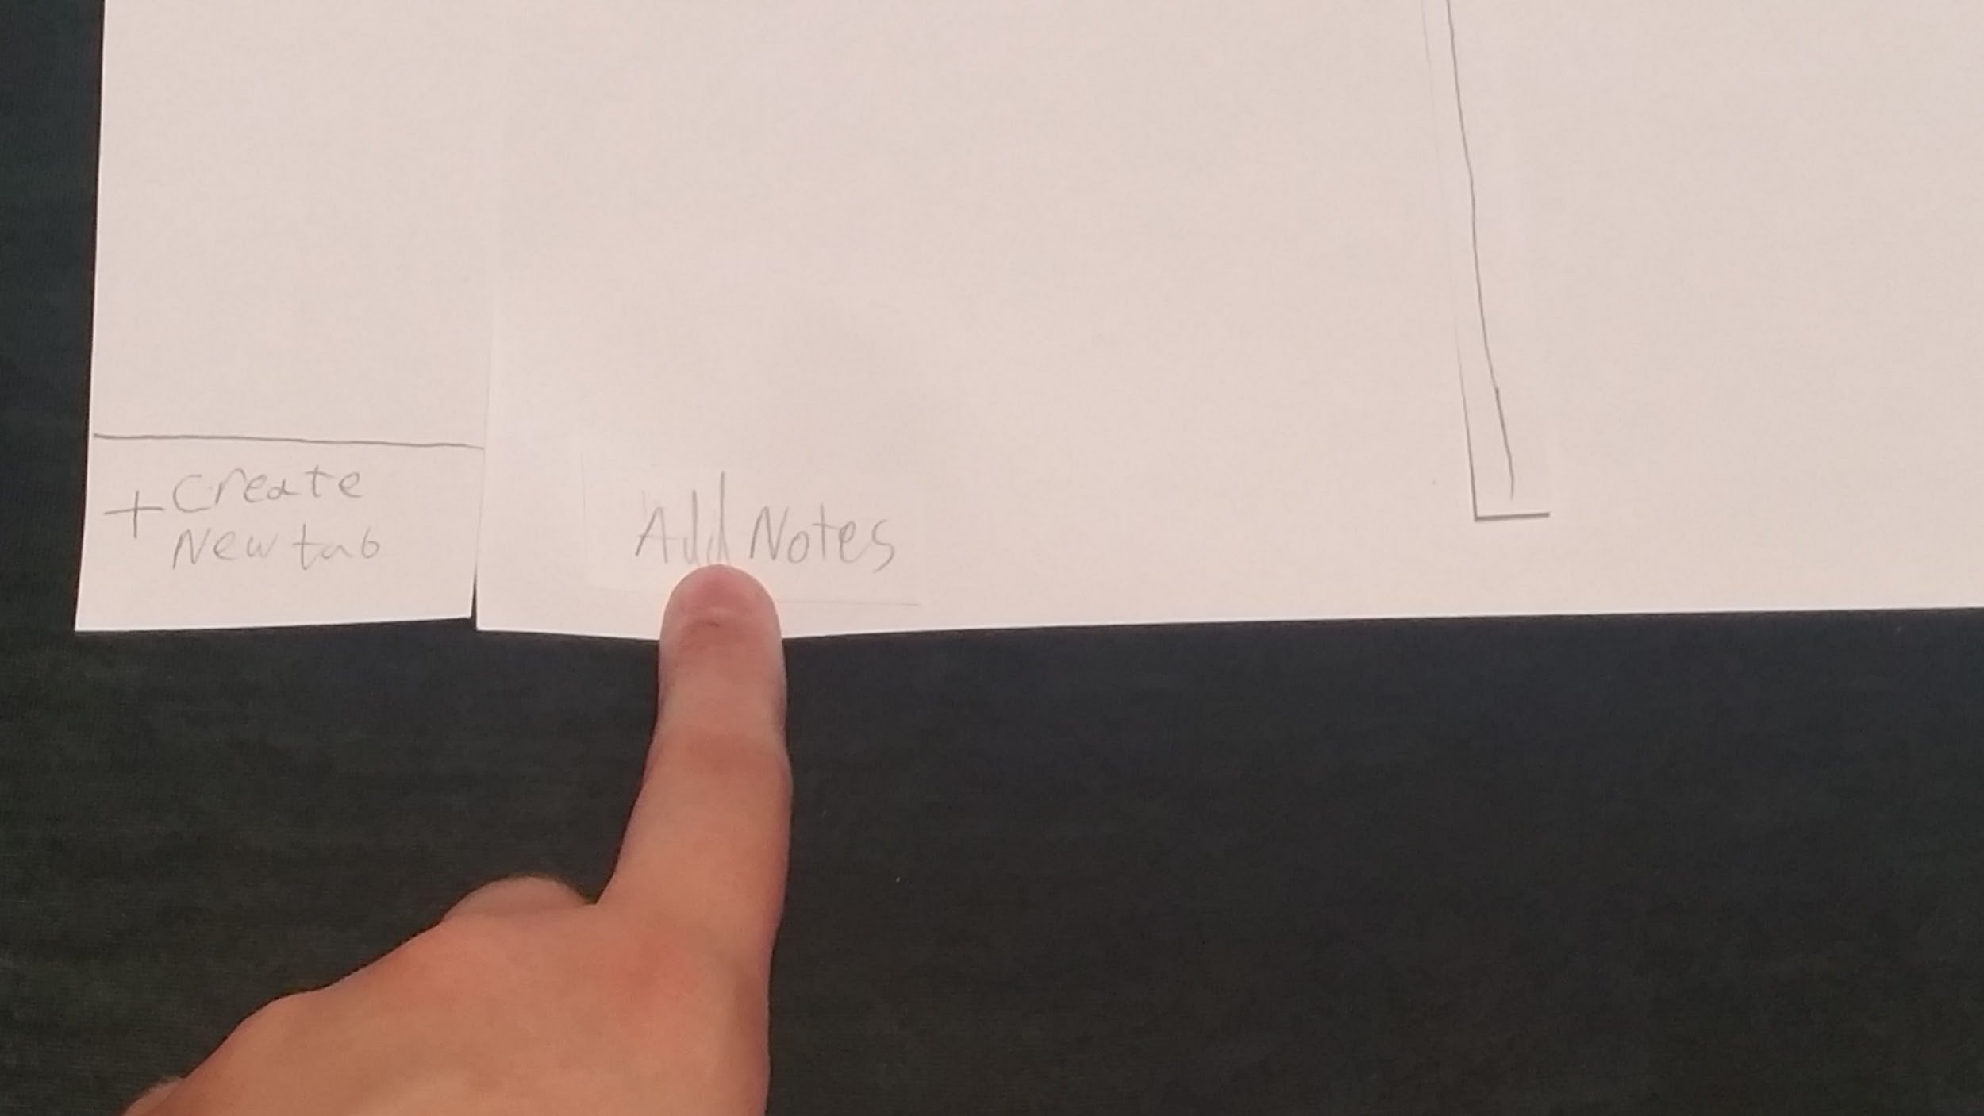
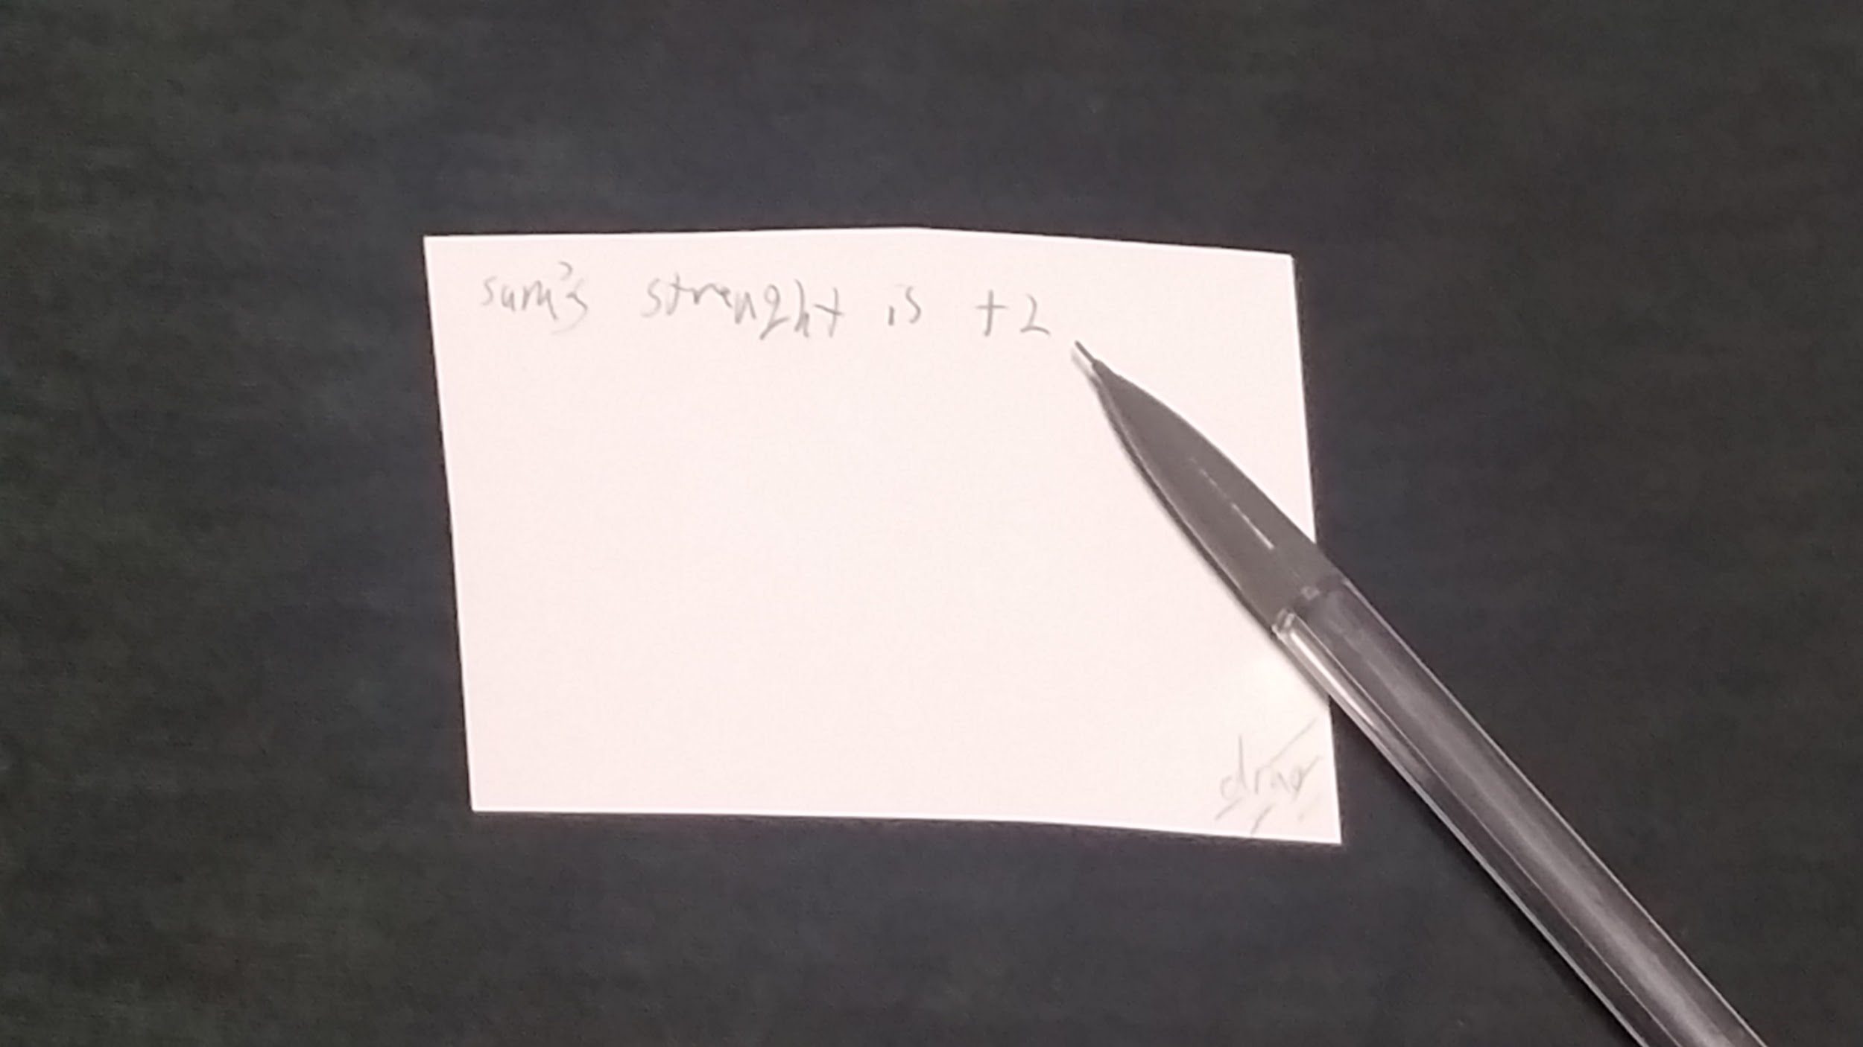
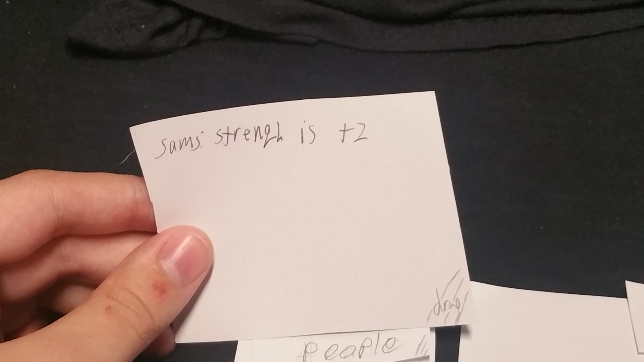
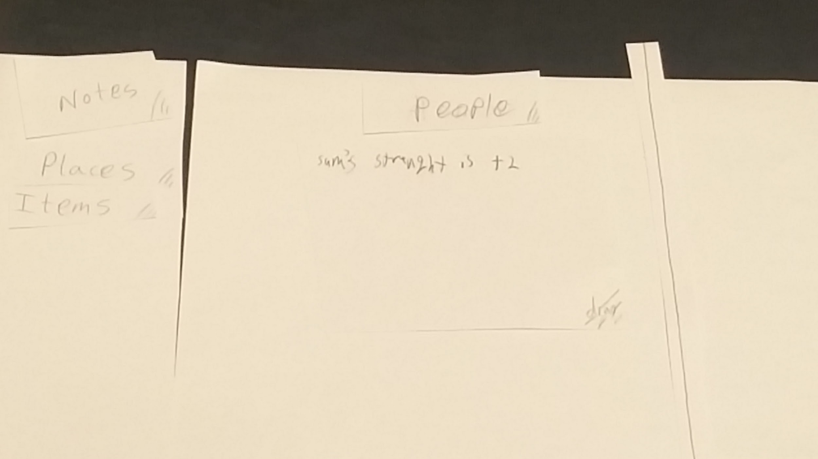
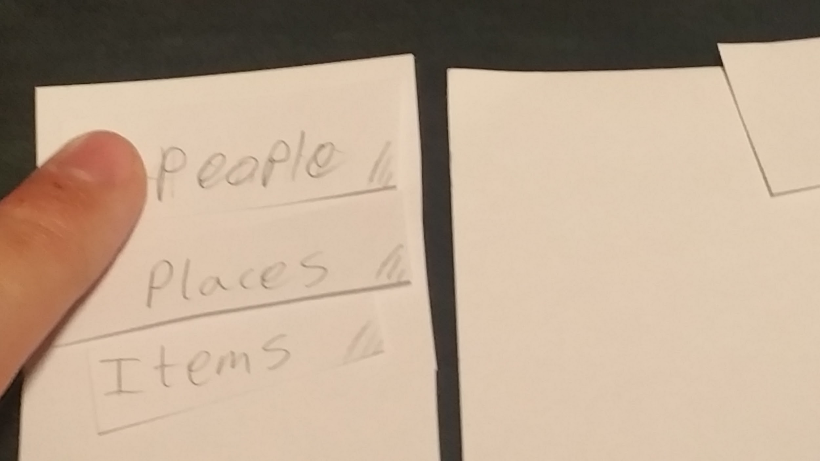
Task 1: Write a new note and store it under a tab.

Slide 18
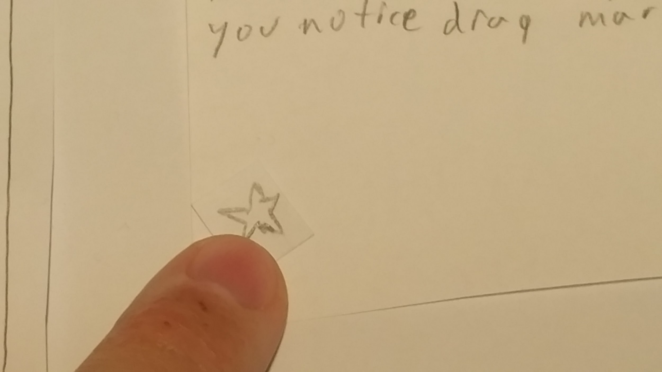
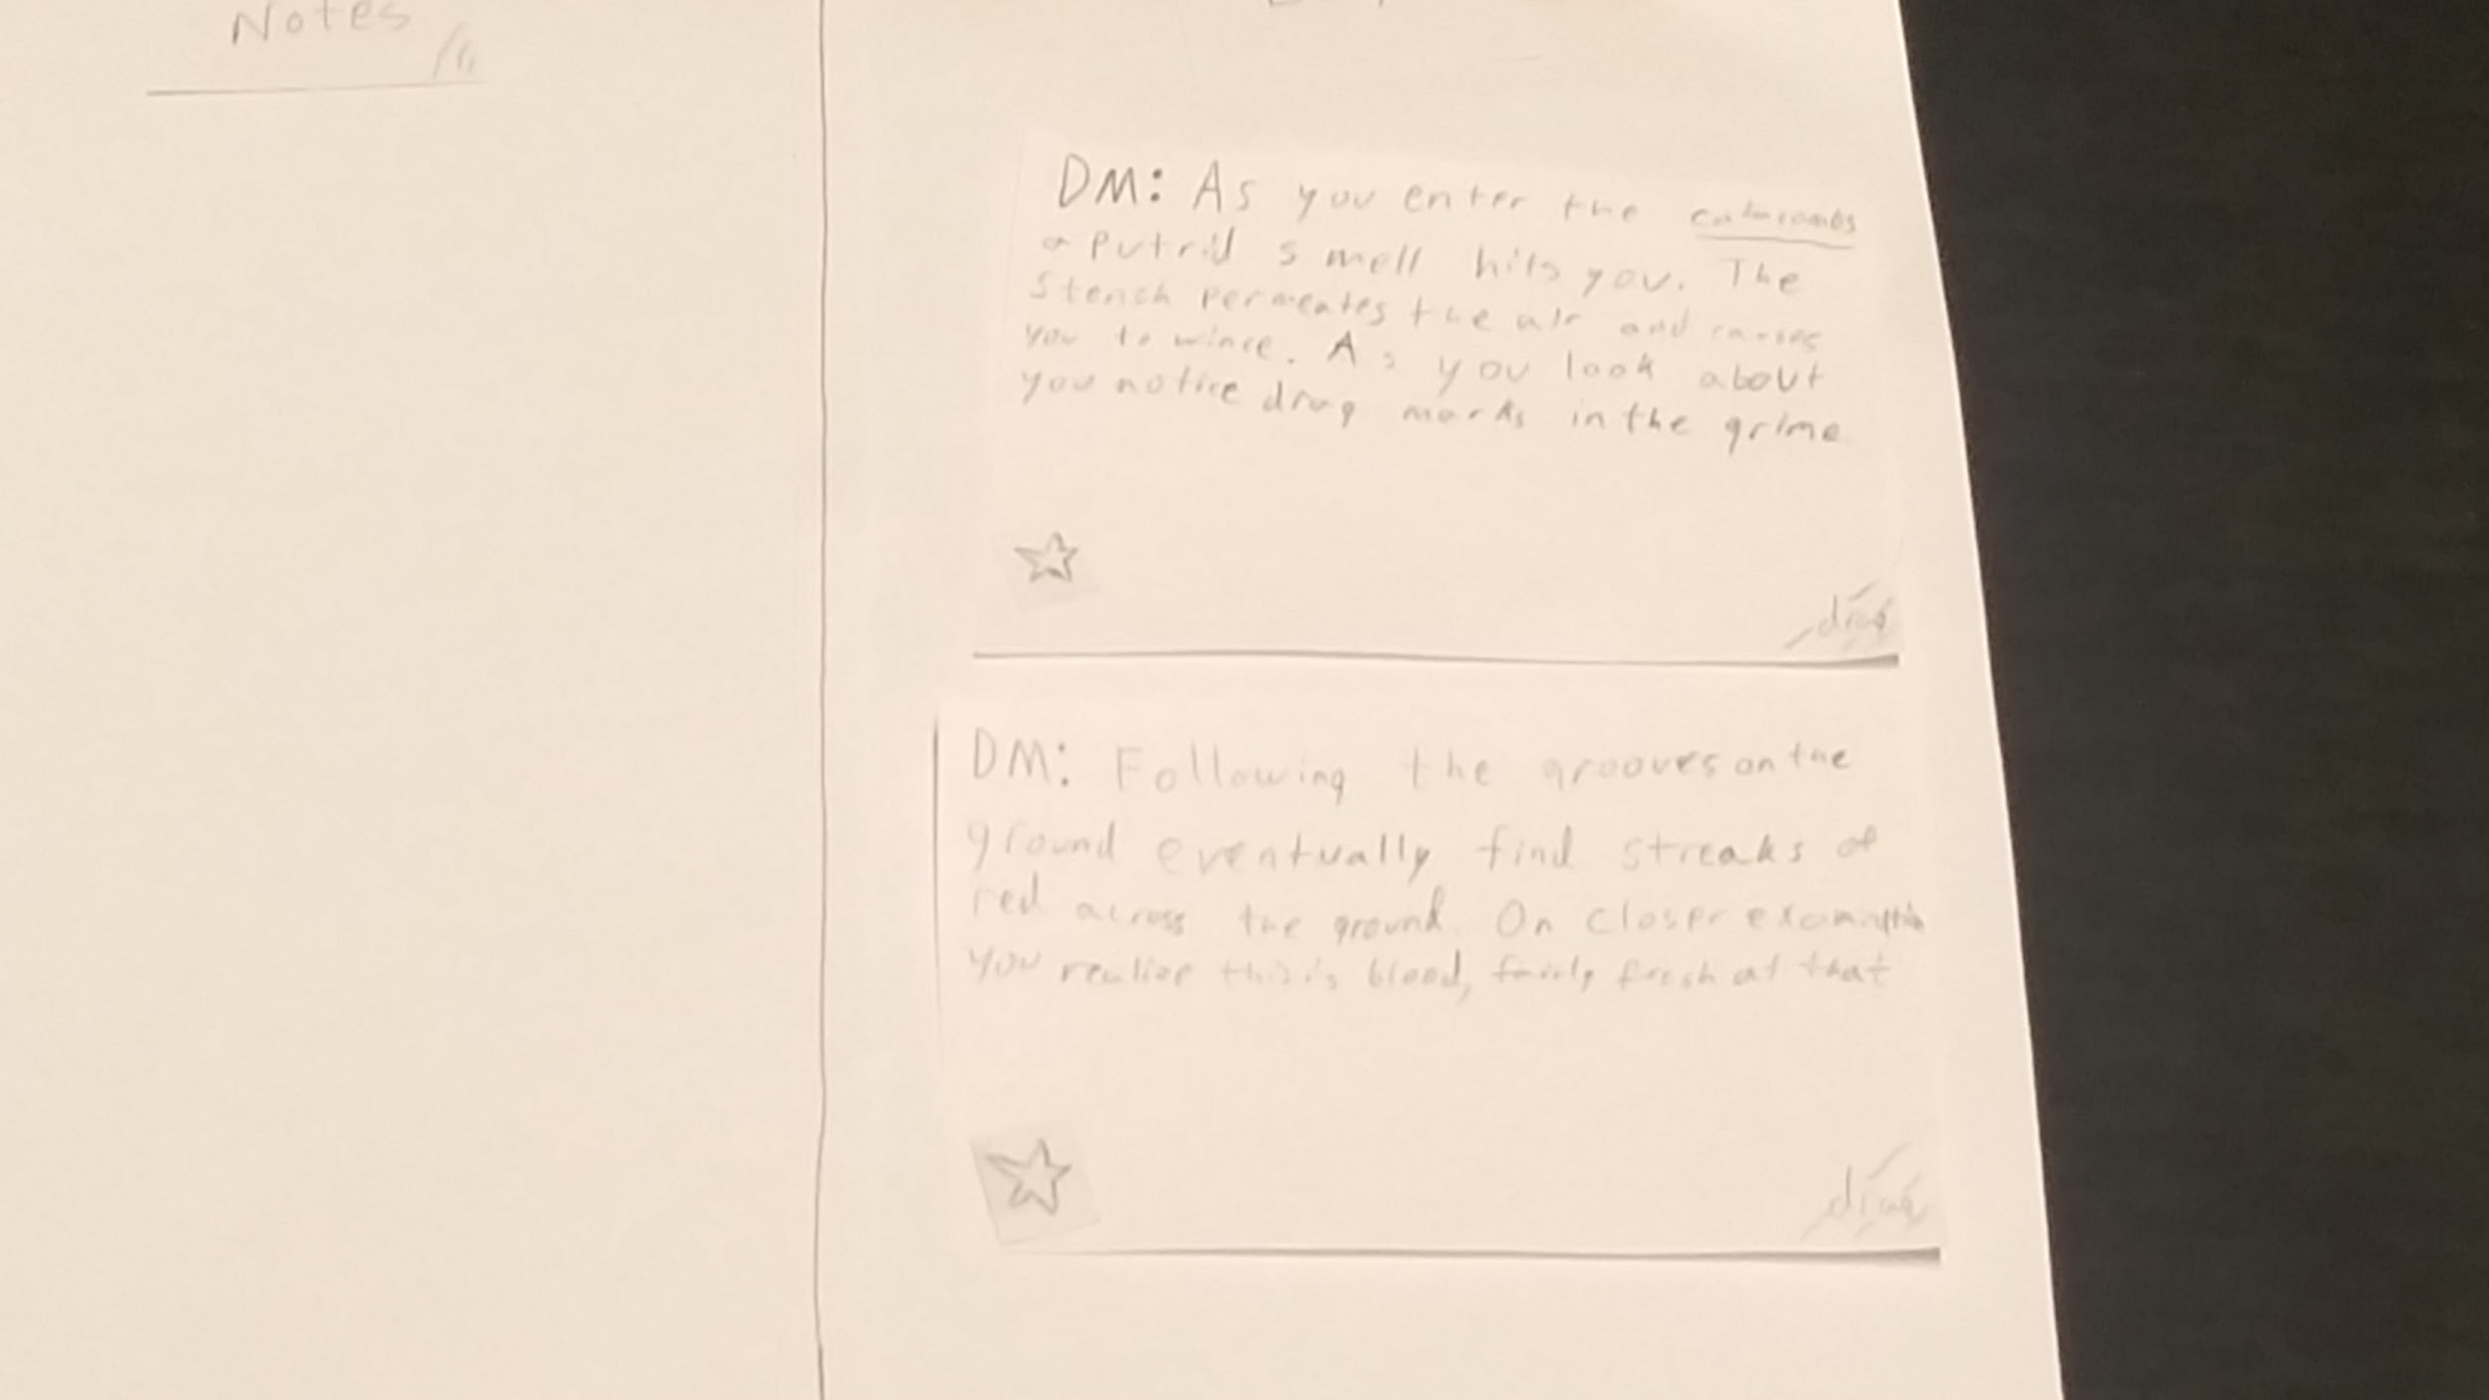
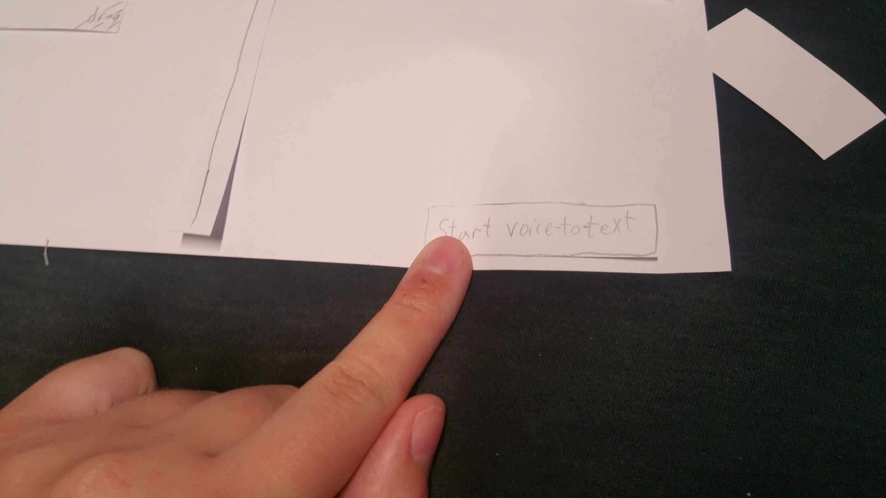
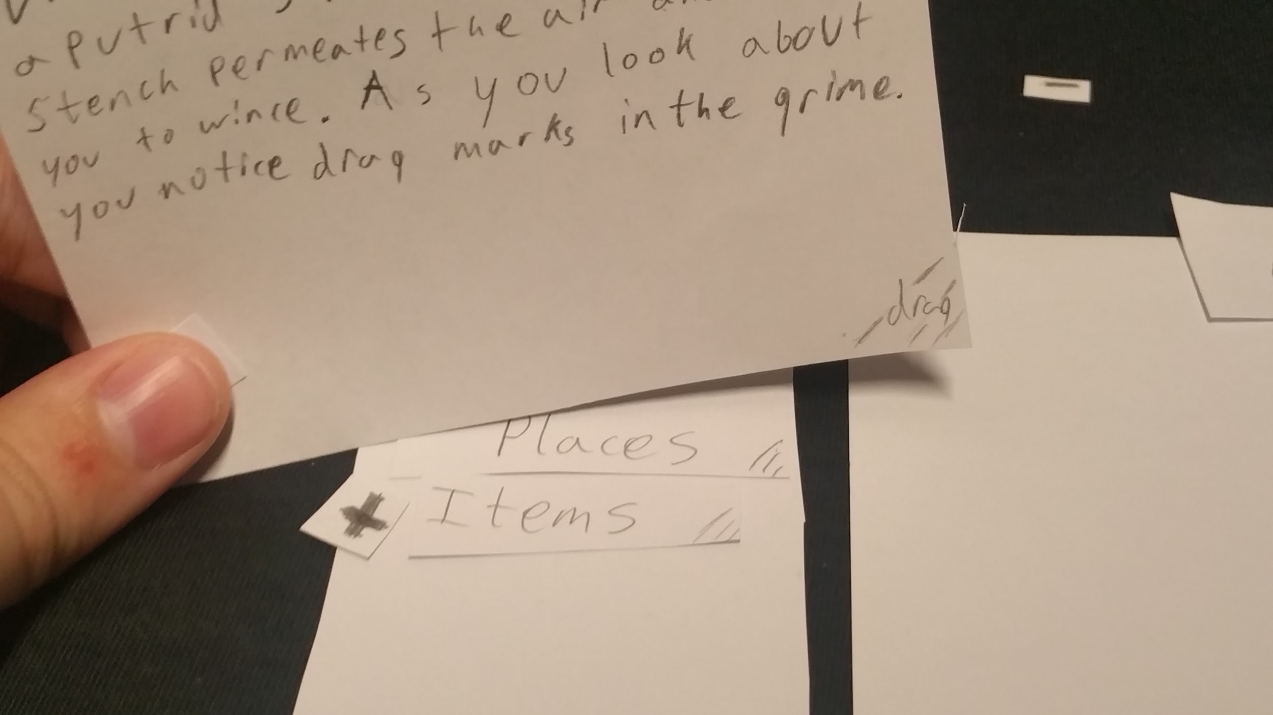
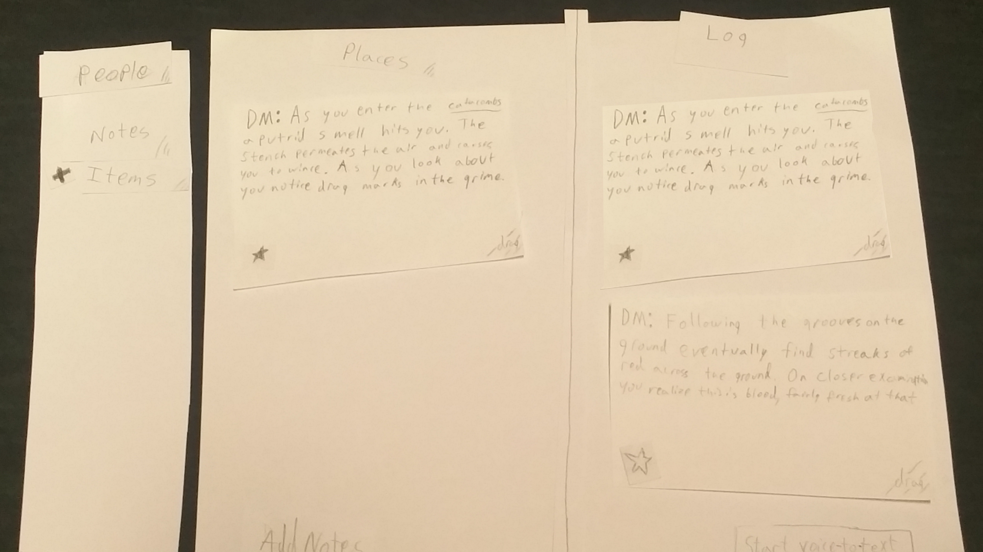
Task 2: Star text from the DM voicelog and sort it into a tab.

Slide 19
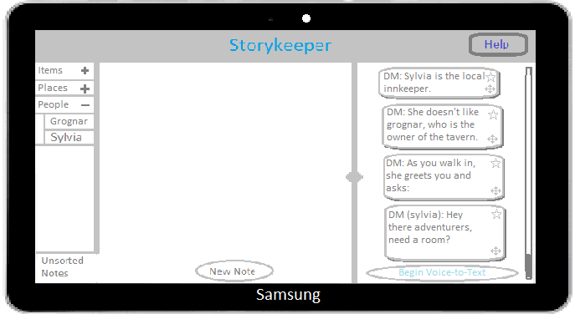
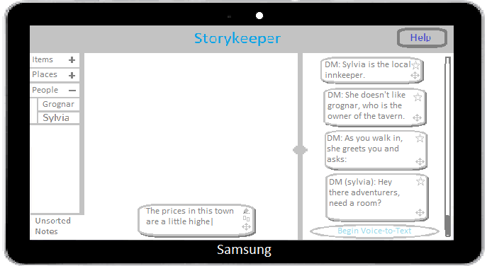
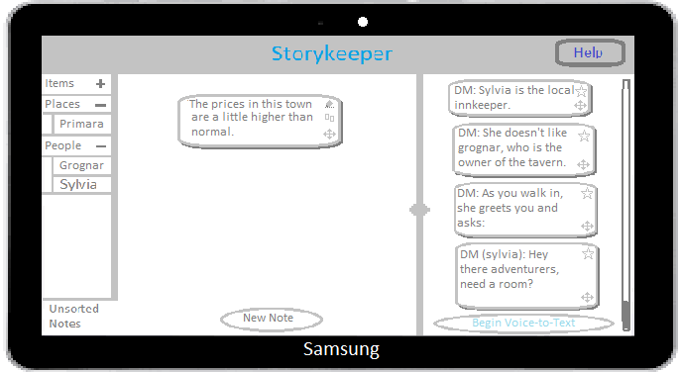
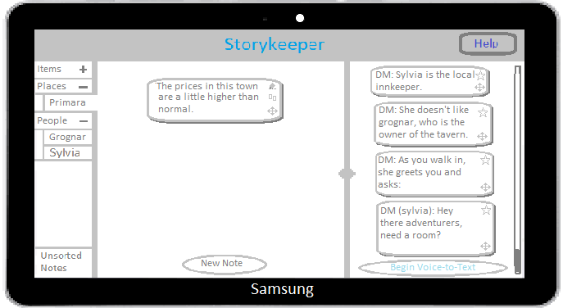
Digital Mock-up
Task 1: Write a new note and store it under a tab.

Slide 20
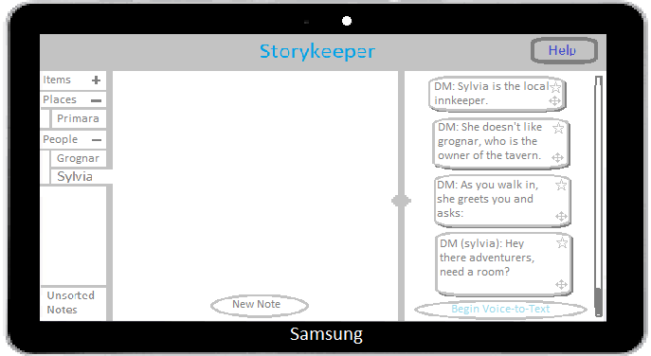
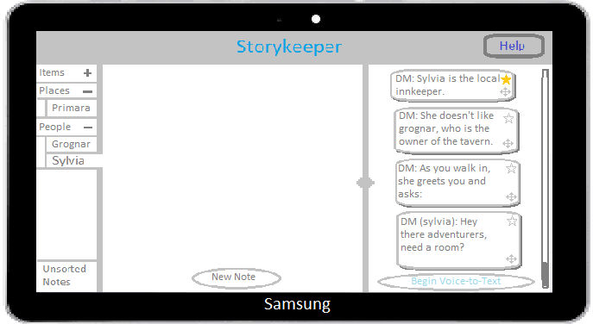
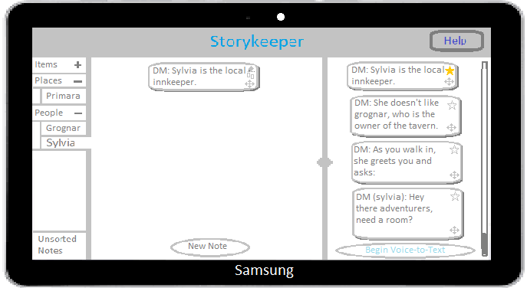
Digital Mock-up
Task 2: Star text from the DM voicelog and sort it into a tab.

Slide 21
Summary
What we learned:
Never assume:
If there isn’t an explicit affordance, the user won’t know what to do
We are not the user:
Our users will have different expectations and assumptions
What we consider a clear indication won’t always be clear to others.

Slide 22
Questions?

